Slide 1


Foundations of
Scientific Computing
(SciComp 101)
Dave Biersach
dbiersach@bnl.gov
Session 08 Histograms and Code Breaking

Slide 2
Session 08 – Goals
Create and manipulate Python strings
Understand ASCII as an encoding mechanism
Read an ASCII text file stored on disk into an array
Encrypt and decrypt files using “Caesar Shift”
Generate a histogram of character frequencies within a file
Perform bigram analysis on unreadable ciphertext to determine the author’s native language

Slide 3
Python Strings
Textual data in Python is handled with str objects, commonly known as strings
A Python string is an array of integers representing Unicode symbols – they are not like "C" strings, where each character is encoded using a fixed number of bits
Python does not have a character type – in Python, an individual character is simply another string with len() = 1
Because a Python string is a Sequence type, individual elements can be directly accessed using the [] operator
Matched single or double quotation marks must surround string literals in your Python source code

Slide 4
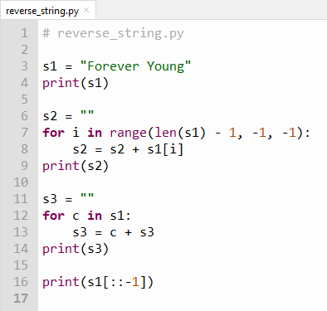
Edit reverse_string.py
①
②
③
④
⑤
⑥

Slide 5
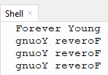
Run reverse_string.py

Slide 6
Python Slicing Syntax
Slicing syntax: [start : stop : step]
If no value is given for the start index, the default value of 0 is assumed
If no value is given for the stop index, the default value is the index of the last accessible element in the list (len), and the stop value is exclusive
If no value is given for the step value, the default value of 1 is assumed

Slide 7
ASCII (“as-key”)
American Standard Code for Information Interchange
ASCII was the most common legacy International standard used across the Internet until 2007
Since 2008, ASCII has been surpassed by UTF-8 (Universal Transformation Format), which includes ASCII as a subset
ASCII is an 8-bit (one-byte) character encoding scheme
ASCII maps most of the characters in the (Western) languages descending from Latin to a specific integer value
In ASCII, there is a 1:1 correspondence between a letter and a number, and every character is always one byte long
Inside a computer, all letters, punctuation marks, and even numbers (when treated as strings) are encoded using either ASCII or UTF-8

Slide 8
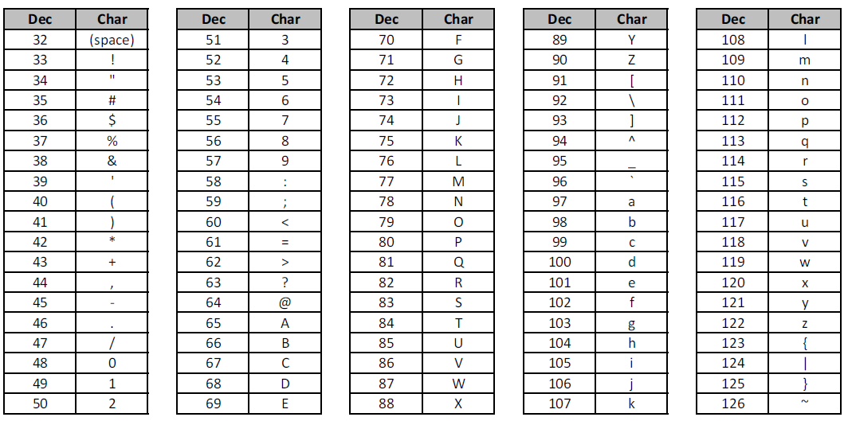
ASCII range for common English characters

Slide 9
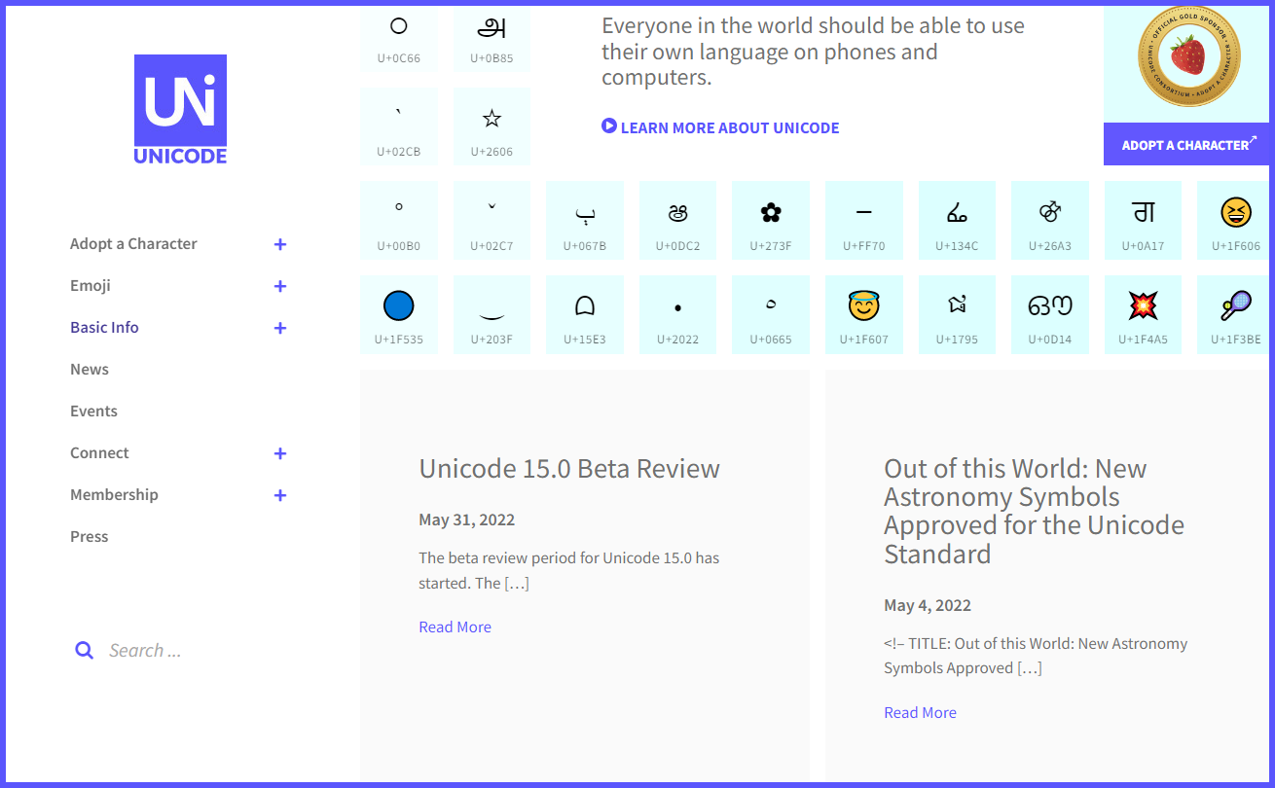
Unicode Maps Symbols to Codepoints
https://home.unicode.org
Unicode maps a symbol to a codepoint (a 16 to 21-bit integer)

Slide 10
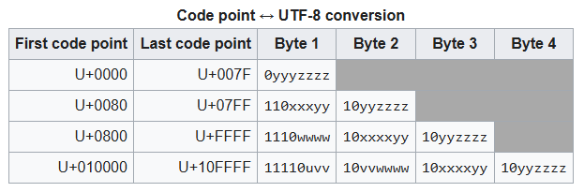
UTF-8 Encodes Unicode Codepoints
https://en.wikipedia.org/wiki/UTF-8
UTF-8 encodes codepoints into a variable number of bytes (from 1 to 4 bytes maximum)
To encode means to package or wrap
Original ASCII
$$\left[0, 127\right]$$
$$\left[128, 2047\right]$$
$$\left[2048, 65535\right]$$
$$\left[65536, 1,114,111\right]$$
Unicode can uniquely identify/encode
$1,114,111$ distinct characters/symbols!
UTF-8 preserves the original ASCII character set

Slide 11
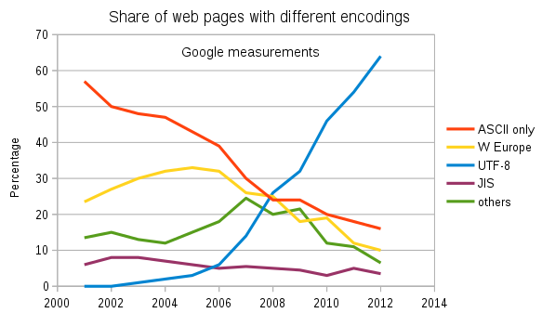
UTF-8 Encodes Unicode Codepoints
https://en.wikipedia.org/wiki/UTF-8
Its 2025.
You must understand UNICODE and UTF-8

Slide 12
Creating a Frequency Histogram
Consider Lincoln’s Gettysburg Address:
Four score and seven years ago our fathers brought forth on this continent a new nation, conceived in liberty, and dedicated to the proposition that all men are created equal.
Now we are engaged in a great civil war, testing whether that nation, or any nation so conceived and so dedicated, can long endure…
We want to perform a histogram analysis of Lincoln’s speech that has been saved as an ASCII text file
What letter do you think occurs most frequently in English?
Spaces (ASCII value 32) usually occur most often because we use spaces as a word breaker

Slide 13
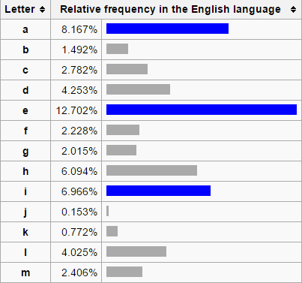
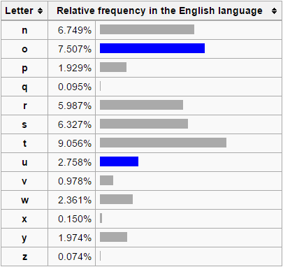
Letter Frequencies in the English Language
ETAOIN SHRDLU

Slide 14
ASCII Text Files – A “stream”
A file on disk is essentially just a byte array
In many computer languages, a byte is an 8-bit unsigned integer between 0 and 255
We can declare a byte array and load it with the contents of a file
A stream of file bytes in memory is called a buffer
We can then randomly access individual characters within the file
Use the normal [] operator on a bytes object (immutable) or a bytearray (where you can modify the value at any index)
We only need to specify an index value to get a specific byte
Note that native Python does not separate the concept of signed vs. unsigned integers and has no specific byte data type

Slide 15
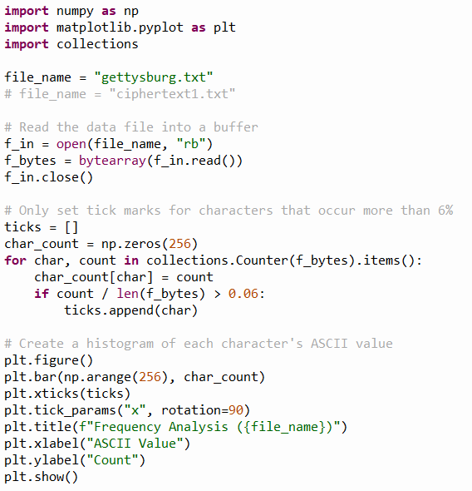
Open freq_histogram.py
①
②
③
④
⑤
⑥
⑦
⑧
⑨
⑩

Slide 16
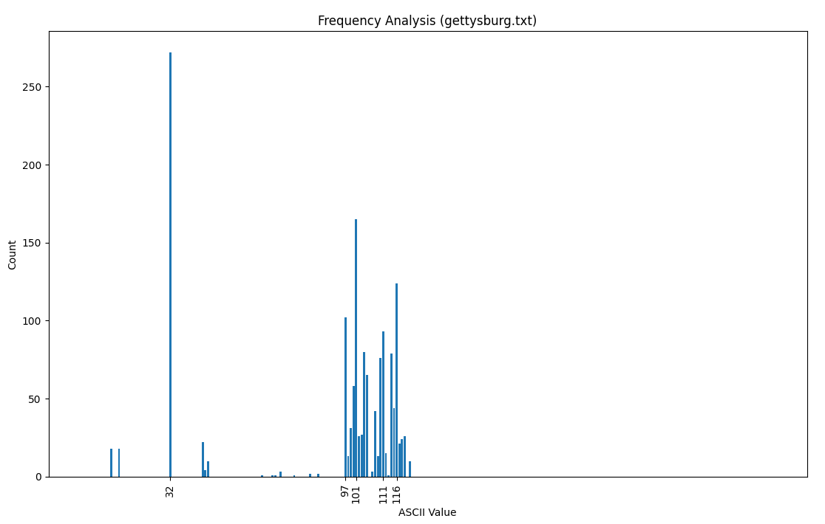
Run freq_histogram.py
ASCII value 32 (space) appears most often
ASCII value 101 (e) is the most frequent letter in the file

Slide 17
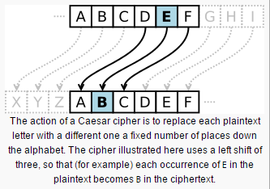
The Caesar Shift Cipher
Roman Emperor Julius Caesar used a simple (but effective for its time) encryption scheme for his private correspondence
To create “ciphertext” from “plaintext” shift the original letters forward (or backward) a given number of letters in the alphabet
To decrypt the message, reverse the sign of the shift
Encryption Key = -3
Decryption Key = 3

Slide 18
The Caesar Shift Cipher
Consider Lincoln’s Gettysburg Address:
Four score and seven years ago our fathers brought forth on this continent a new nation, conceived in liberty, and dedicated to the proposition that all men are created equal.
Now we are engaged in a great civil war, testing whether that nation, or any nation so conceived and so dedicated, can long endure…
How effective is the Caesar Shift at encrypting plaintext?
What if we shifted each letter by just one position?
Simply add +1 to the ASCII value of each plaintext character
Save the shifted values to a new ciphertext file

Slide 19
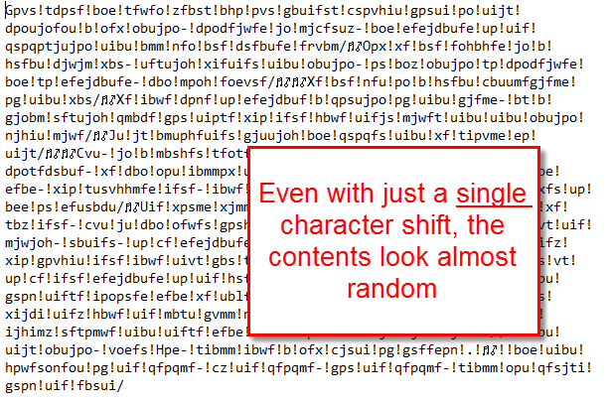
The Caesar Shift Cipher

Slide 20
The Caesar Shift Cipher
If we are given a text file written in English and encrypted by a Caesar Shift, can we figure out what shift value was used?
We could use “brute force” and try every possible value to see what shift produces legible prose…
But we'd need to possibly try every shift value from +1 to +255
It would take a long time to sift through all the decrypted files because all incorrect shift values generate more gibberish
Can we gleam any insight from analyzing the character histogram of the encrypted file?

Slide 21
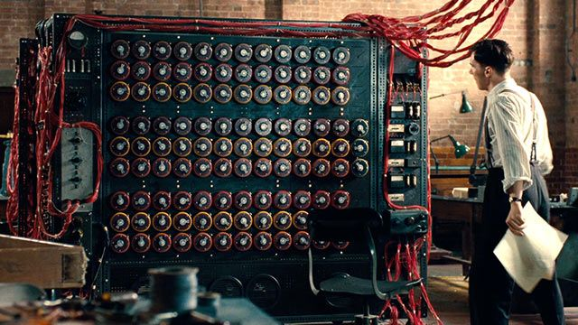
Caesar Decrypt
Your mission is to decrypt the ciphertext1.txt file
What if the survival of your country depended upon your ability to crack the encryption?

Slide 22
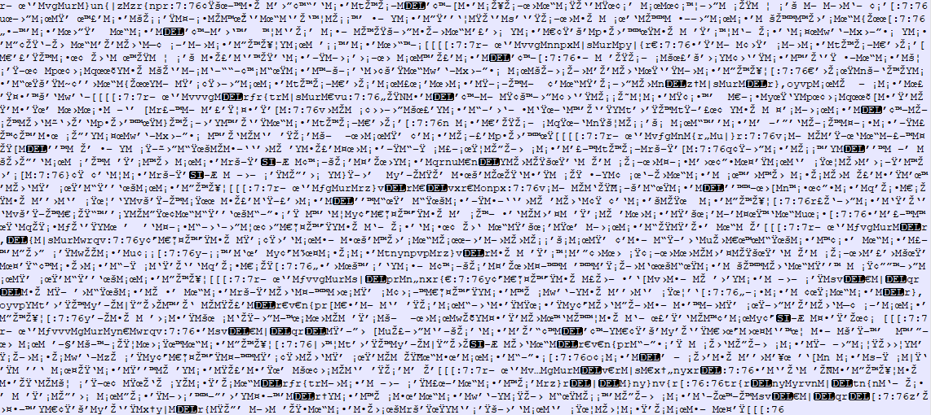
ciphertext1.txt
What shift made this?

Slide 23
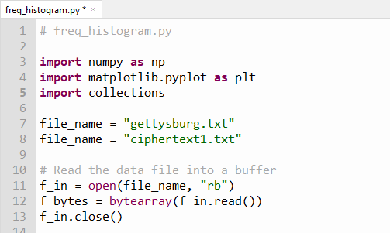
Edit freq_histogram.py
Remove the # comment from line 8
①

Slide 24
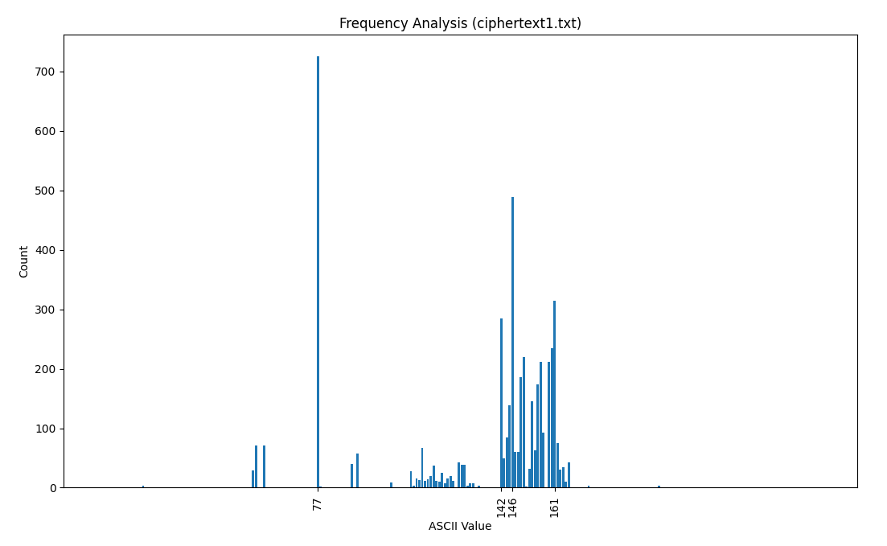
Run freq_histogram.py
What shift value was used for this Caesar encryption?

Slide 25
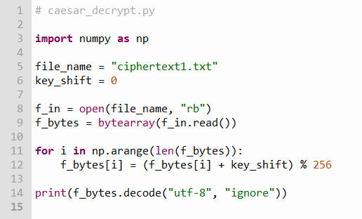
Open caesar_decrypt.py
①
②
③
④
⑤
⑥
⑦

Slide 26
Edit caesar_decrypt.py
Set the correct key_shift value in line 6
①

Slide 27
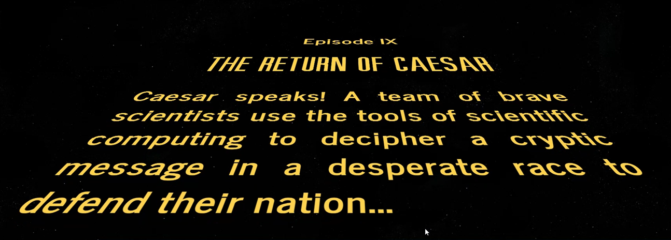
Run caesar_decrypt.py

Slide 28
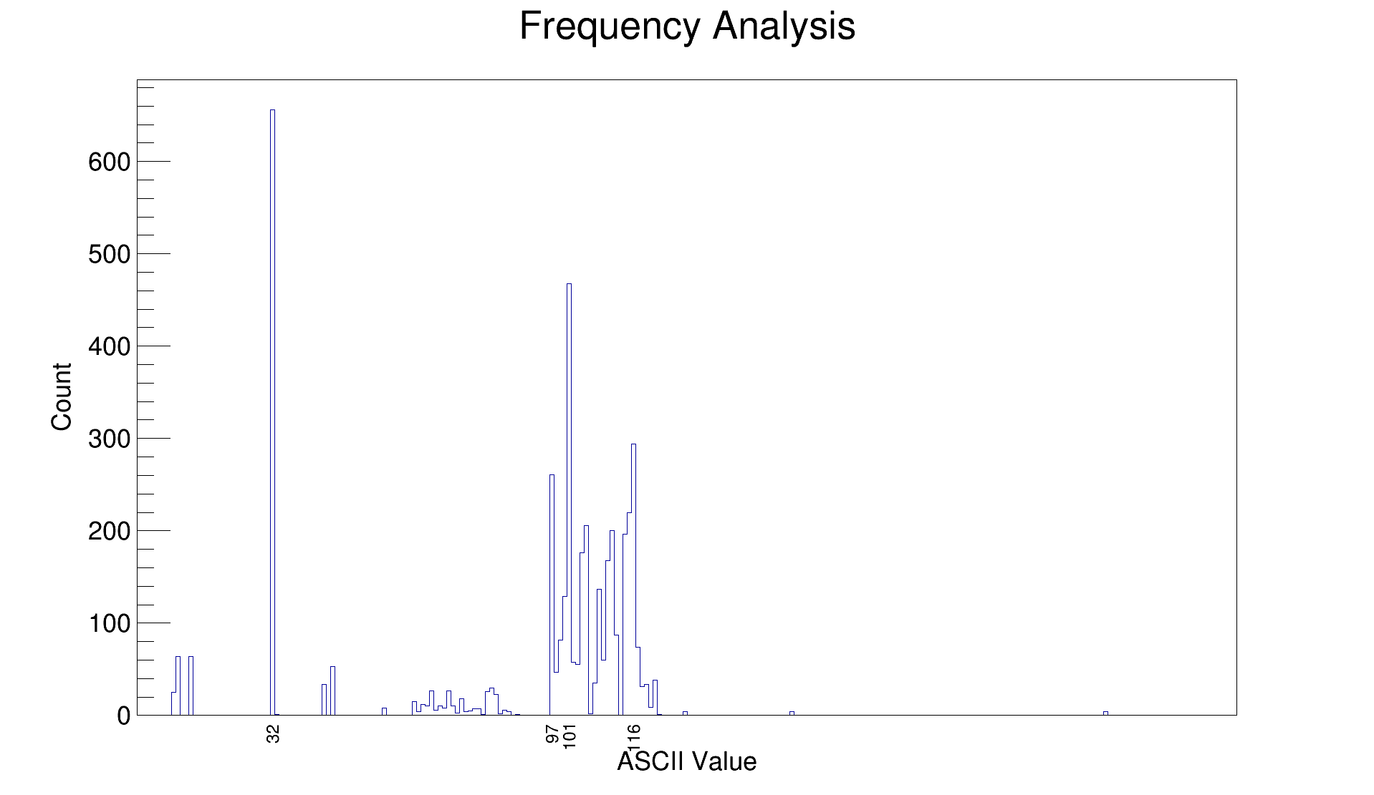
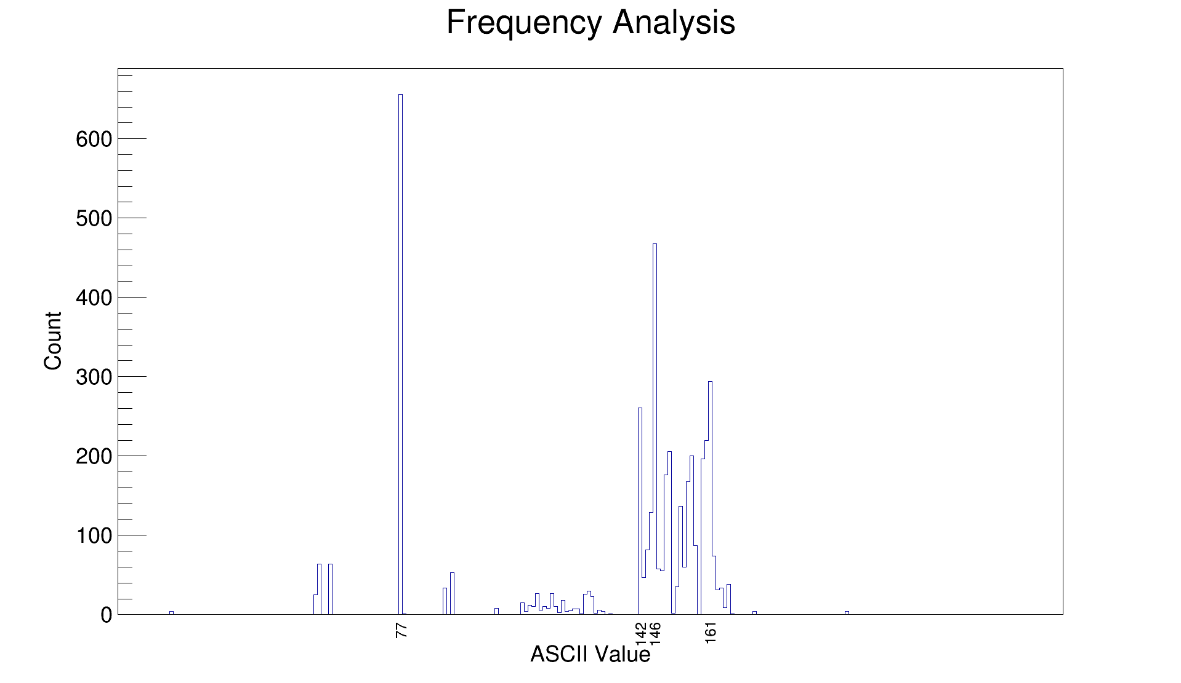
plaintext
Notice that the relative letter frequencies (individual bar heights) are the same before and after the encryption
ciphertext

Slide 29
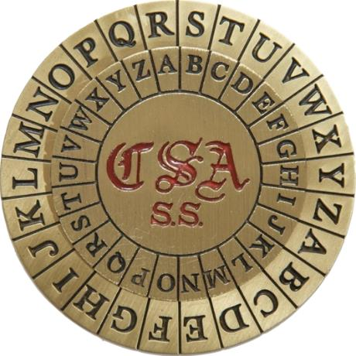
The Caesar Shift Cipher
Because the Caesar Shift is a monoalphabetic substitution cipher, it is susceptible to cryptanalysis (breaking) by frequency analysis

Slide 30
Bigram Analysis
Most Western (Latin influenced) languages have a unique fingerprint from their most frequent bigrams (two-letter pair)
In English the bigrams TH and HE occur most often, since “the” is the most frequent word in English
All languages have definite articles like “the” but each language spells theirs differently, and this helps establish a distinct statistical profile for each language
Linguists and statisticians have compiled lists of the most frequent bigrams per language
We can analyze the bigrams in President Kennedy’s Rice University Speech - where he set the goal in 1962 for the USA to reach the moon before 1970!

Slide 31
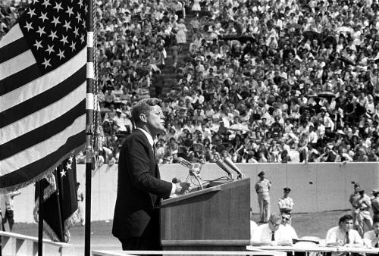
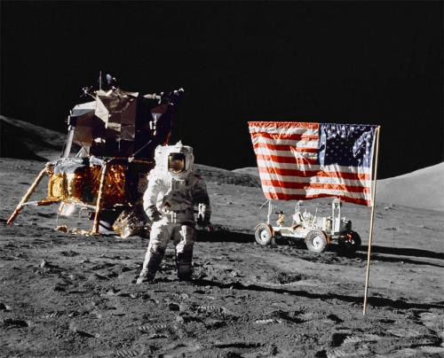
Kennedy’s Moon Speech in 1962
“We choose to go to the moon in this decade and do the other things, not because they are easy, but because they are hard, because that goal will serve to organize and measure the best of our energies and skills, because that challenge is one that we are willing to accept, one we are unwilling to postpone, and one which we intend to win.”

Slide 32
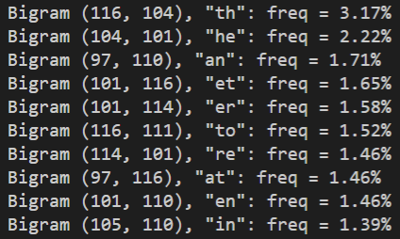
Bigram Analysis of Kennedy’s Moon Speech in 1962

Slide 33
Kennedy’s Moon Speech Translated
Nous choisissons d'aller sur la lune. Nous choisissons d'aller sur la lune dans cette décennie et de faire d'autres choses, non pas parce qu'ils sont faciles, mais parce qu'ils sont difficiles, parce que ce but servira à organiser et mesurer le meilleur de nos énergies et de compétences, parce que ce défi est l'un que nous sommes prêts à accepter, que nous ne sommes pas disposés à reporter, et celui qui nous avons l'intention de gagner.
Elegimos ir a la Luna. Elegimos ir a la Luna en esta década y hacer las otras cosas, no porque sean fáciles, sino porque son difíciles, porque esa meta servirá para organizar y medir lo mejor de nuestras energías y habilidades, porque ese desafío es uno que estamos dispuestos a aceptar, uno no estamos dispuestos a posponer, y uno que tenemos la intención de ganar.
Wir wählen, um zum Mond zu fliegen. Wir wählen, um zum Mond in diesem Jahrzehnt zu gehen und die anderen Dinge, nicht weil sie leicht sind, sondern weil sie hart sind, denn das Ziel wird dazu dienen, zu organisieren und zu messen, das Beste aus unserer Energien und Fähigkeiten, denn das ist eine Herausforderung dass wir bereit sind zu akzeptieren, das wir nicht bereit sind, zu verschieben, und eine, die wir beabsichtigen, zu gewinnen.

Slide 34
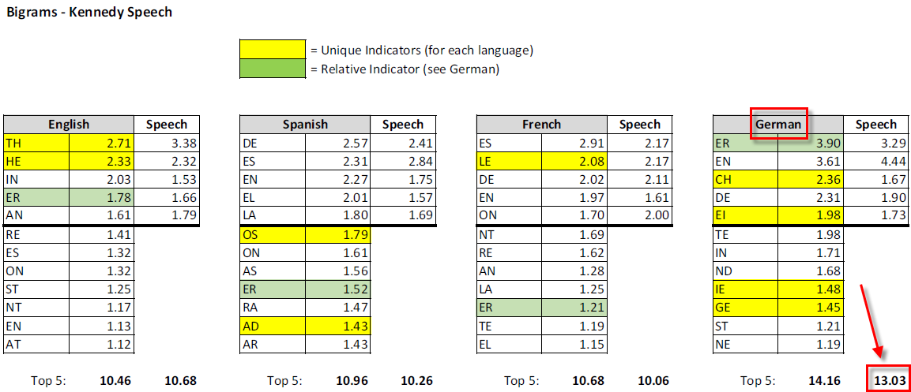
Bigram Statistics by Language
German is the most consistent language for bigrams

Slide 35
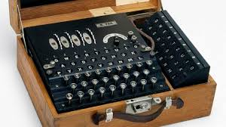
Frequency of Bigrams
I found an encrypted text file on the dark web
It was encrypted with a monoalphabetic substitution cipher
Frequency analysis does not suggest a simple Caesar shift was used
Rather, a different shift value was used for each plaintext letter!
Even if we are unable to break the encryption, can we tell what language was used when writing the plaintext?
Q: Are you serious? How can you possibly discern the author's language if you cannot even read the contents in the first place?
A: Enigma was also unbreakable

Slide 36
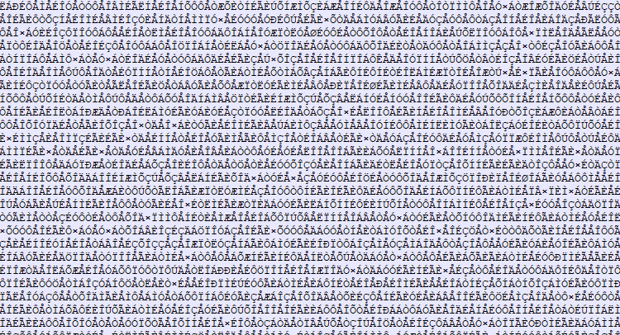
bigram_ciphertext.txt
What was the source language?

Slide 37
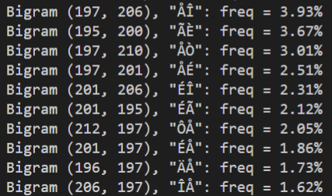
Bigram Frequency Analysis of Ciphertext
Consider the frequencies of the most recurring bigrams in the ciphertext.
What language has this level of bigram consistency?

Slide 38
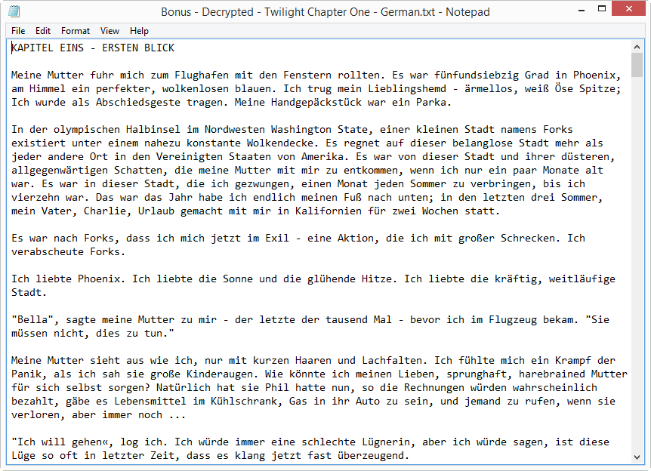
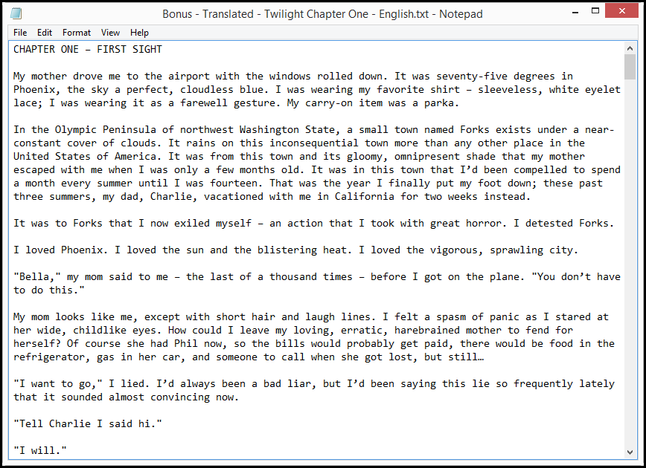

The Original Plaintext

Slide 39
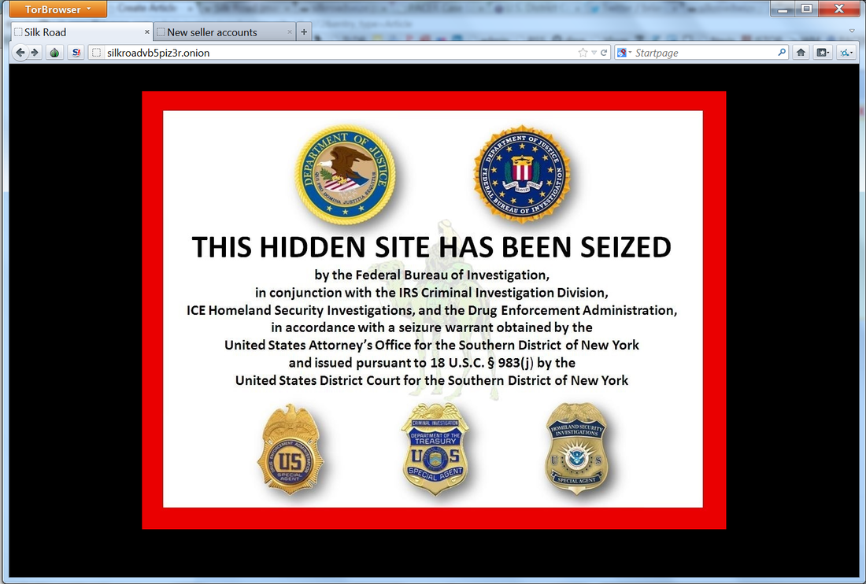
The Fallacy of the Smarter Criminal

Slide 40
Session 08 – Now You Know…
Python strings are essentially an array of Unicode symbols
ASCII is an international standard for encoding most Western language characters into a single byte and is a subset of UTF-8
Many older devices will emit data files formatted as ASCII text, but newer systems save data natively using UTF-8
Character histograms enable frequency analysis
Caesar-Shift ciphers are not very secure
All monoalphabetic substitution ciphers can be broken with Bigram analysis
Using “brute force” to crack a cipher is often intractable – get statistics to help you!

Slide 41
Task 08
Decipher ciphertext2.txt

